Slide 1


EXERCISE 4 – NuSmv
“Formalize with NuSMV the system described in the slides 30 of the file temporal logic 23. Check the requirements as listed in the slides 31 and 32.
Make a presentation of the model and the requirements checking.
Save it into your work floder.”
Course: Formal Methods 2024/2025
Team: Federica Picca -
Alberta Motca Schnabel

Slide 2
Specifications of system properties reported in the slides
The elevator should not move if the door is open.
G(¬door_closed → ¬(direction_up ∨ direction_down))
2. Whenever the door is open, it will eventually be closed.
G(¬door_closed → F door_closed)
3. Likewise, whenever the door is closed, it will eventually be open.
G(door_closed → F ¬door_closed)
4. The elevator can move upward only if the floor is not the highest.
G(direction_up → ¬floor_5)
5. Similarly, the elevator can move downward only if the floor is not the lowest.
G(direction_down → ¬floor_1)

Slide 3
6. The elevator can visit any floor infinitely often.
For example,
GF floor_4
7. When a floor is requested, the elevator will eventually stop at the floor. For example:
G(button_3 → F floor_3)
8. When the elevator is traveling upward, it does not change its direction when there are passengers waiting to go to a higher floor. For example:
G ((floor_1 ∨ floor_2 ∨ floor_3) ∧ direction_up ∧ button_4 → direction_up U floor_4)
9. Likewise, when the elevator is traveling downward, it does not change its direction when it has passengers waiting to go to a lower floor. For example:
G ((floor_4 ∨ floor_5 ∨ floor_3) ∧ direction_down ∧ button_2 → direction_down U floor_2)

Slide 4
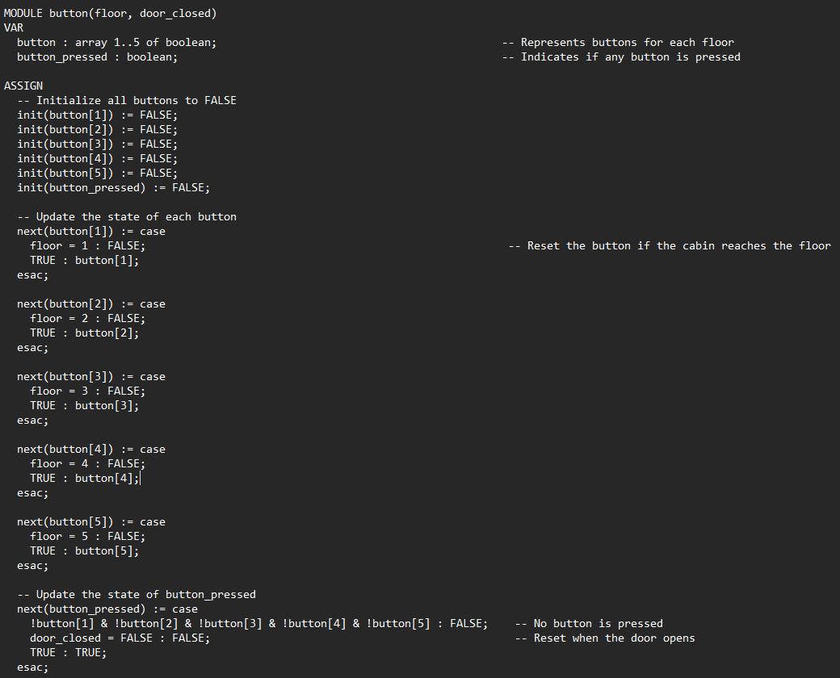
NuSMV code with modules:
BUTTON MODULE
This module models the behavior of elevator buttons for floors 1 to 5
Each button is represented as a boolean in an array and is initialized to FALSE.
The state of each button is updated based on the current floor: a button is reset to FALSE when its corresponding floor is reached.
The «button_pressed» variable indicates whether any button is pressed.

Slide 5
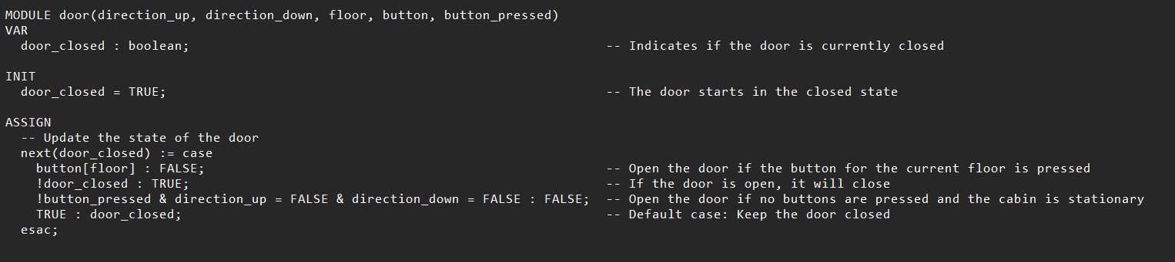
DOOR MODULE
The door module controls the elevator door, which starts in a closed state. The door opens when the button for the current floor is pressed or when the cabin is stationary with no buttons pressed.
The door closes automatically when it is open and no special conditions are met. Otherwise, the door remains in its current state.

Slide 6
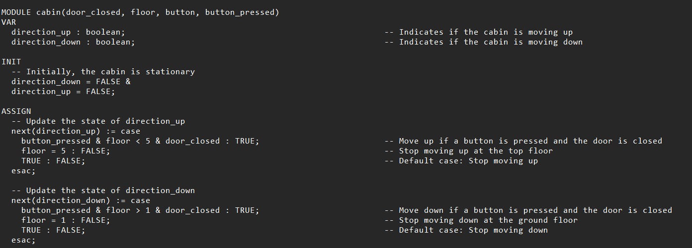
CABIN MODULE
The cabin module controls the movement of an elevator cabin. It moves up when a button is pressed, the door is closed, and the cabin is not at the top floor. It moves down when a button is pressed, the door is closed, and the cabin is not at the ground floor.
The cabin stops moving when it reaches either the top or ground floor, or when no movement conditions are met.

Slide 7
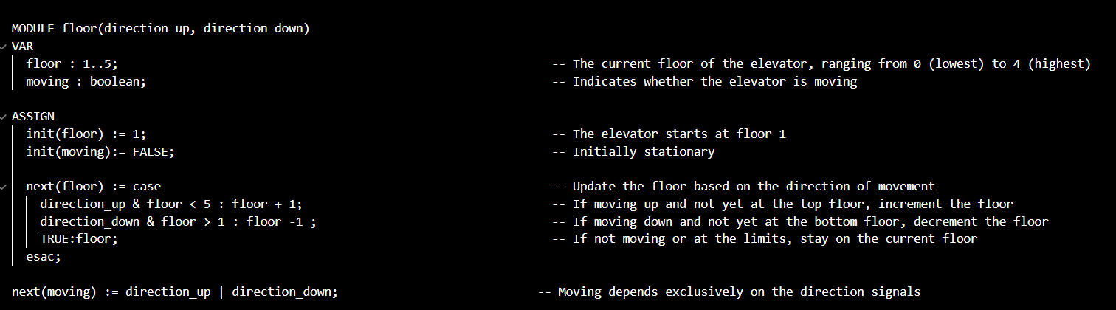
FLOOR MODULE
The floor module is responsible for managing the elevator's current floor and its movement status. Initially, the elevator is set to start at floor 1 and is stationary. The module updates the current floor based on the movement direction: the floor increases when the elevator moves up and decreases when it moves down, but it remains unchanged if the elevator is stationary or has reached the top or bottom floor. The moving status dynamically reflects whether the elevator is in motion, determined by the active direction signals (direction_up or direction_down).

Slide 8
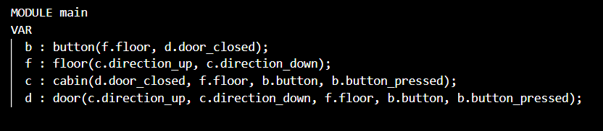
MAIN
The main module integrates all the components of the elevator system. It combines the button, floor, cabin, and door modules to simulate the complete behavior of the elevator. The button module handles button states and presses for each floor. The floor module tracks the current floor and movement status. The cabin module determines the movement direction of the elevator based on button presses and floor position. The door module controls the door’s open and closed states. Together, these interconnected modules define the operation of the elevator system.

Slide 9
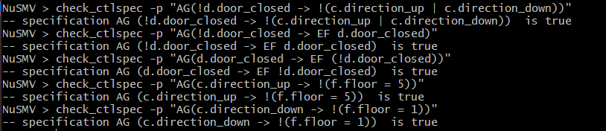
Check of CTL expressions:
1. check_ctlspec -p "AG(!d.door_closed -> !(c.direction_up | c.direction_down))«
2. check_ctlspec -p "AG(!d.door_closed -> EF d.door_closed)"

Slide 10
3. check_ctlspec -p "AG(d.door_closed -> EF (!d.door_closed))
4. check_ctlspec -p "AG(c.direction_up -> !(f.floor = 5))“
5. check_ctlspec -p "AG(c.direction_down -> !(f.floor = 1))"

Slide 11
6. check_ctlspec -p "AG(b.button[5] -> AF (f.floor = 5))"
7. check_ctlspec -p "AG(b.button[4] -> AF (f.floor = 4))"
8. check_ctlspec -p "AG(b.button[3] -> AF (f.floor = 3))"

Slide 12
9. check_ctlspec -p "AG(b.button[2] -> AF (f.floor = 2))"
10. check_ctlspec -p "AG(b.button[1] -> AF (f.floor = 1))"
11. check_ctlspec -p "AG(((f.floor = 1 | f.floor = 2 | f.floor = 3) & c.direction_up & b.button[4]) -> AF (f.floor = 4))"

Slide 13
12. check_ctlspec -p "AG(((f.floor = 4 | f.floor = 3) & c.direction_down & b.button[2]) -> AF (f.floor = 2))"
13. check_ctlspec -p "AG((c.direction_up | c.direction_down) -> f.moving)"
14. check_ctlspec -p "AG(!c.direction_up & !c.direction_down -> !f.moving)"

Slide 14
15. check_ctlspec -p "AG(!f.moving -> AG(f.floor = f.floor))"
16. check_ctlspec -p "AG(b.button_pressed -> EF (!f.moving & !d.door_closed))"
17. check_ctlspec -p "AG((b.button[f.floor] & f.moving = FALSE) -> !d.door_closed)

Slide 15
18. check_ctlspec -p "AG(!b.button_pressed -> !f.moving)"

